Slide 1
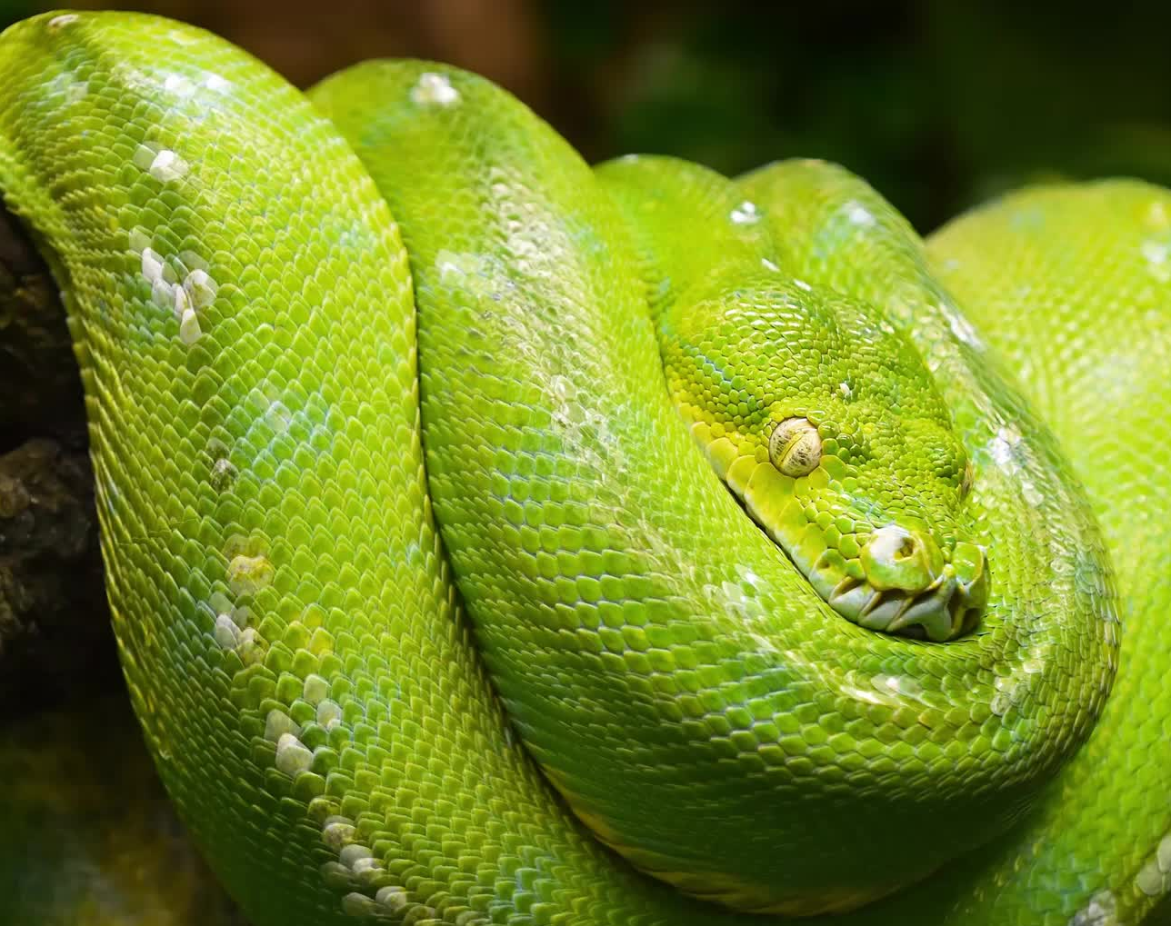
software design pattern in python

Slide 2
Design pattern mostly designed in order to tackle OOP issue as design pattern often interacts with classes, objects and OOP-concept such as Inheritance and Interface.
It’s not code. It is like a description on how to tackle these problems and design a solution.
What exactly is Design Pattern?

Slide 3
classified into 3 types:
1. Creational: These patterns are designed for class instantiation. They can be either class-creation patterns or object-creational patterns.
2. Structural: These patterns are designed with regard to a class's structure and composition(بنيه الفصل وتكوينه). The main goal of most of these patterns is to increase the functionality of the class(es) involved, without changing much of its composition.
3. Behavioral: These patterns are designed depending on how one class communicates with others.
Patterns Types

Slide 4

Factory Method Abstract Factory Method Builder Method Prototype Method Singleton Method
Classification of Creational Design Patterns:

Slide 5
Singleton Pattern
A class that has only a single instance.
It’s commonly used in scenarios like database connections, logging, or configurations where having multiple instances might cause problems.

Slide 6
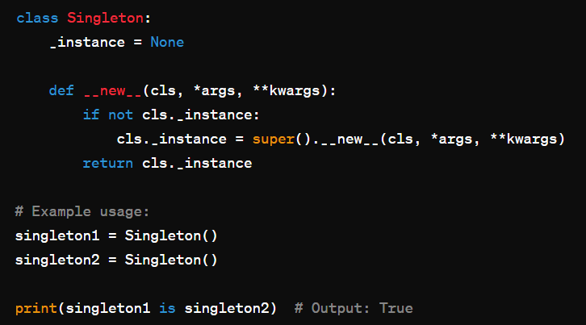
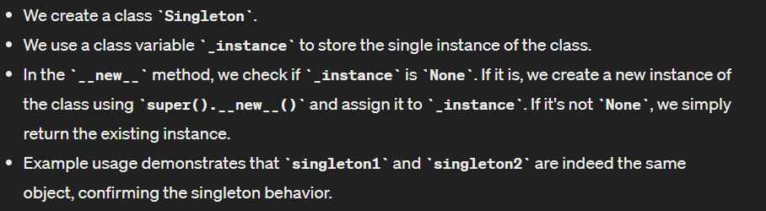

Slide 7
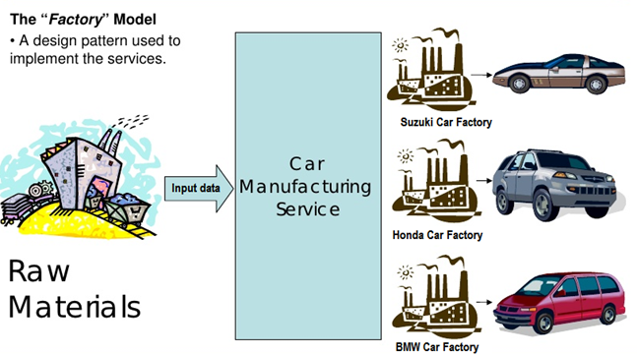
Factory (factory method)
Defines an interface for creating an object, but let subclasses decide which class to instantiate.
The factory class prevents “coupling” of the client code that uses a class, to the class itself.

Slide 8
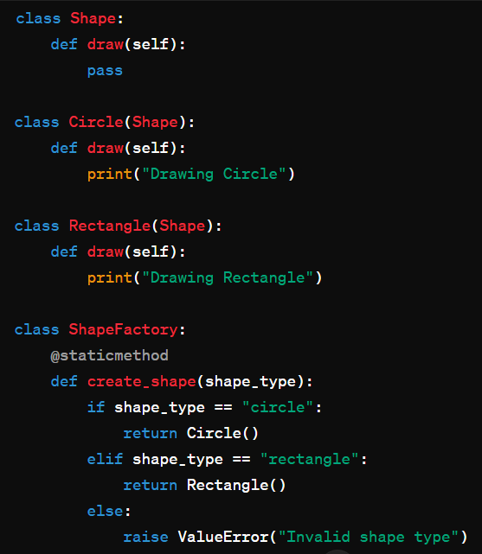
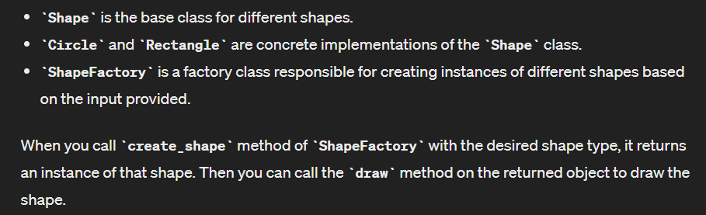
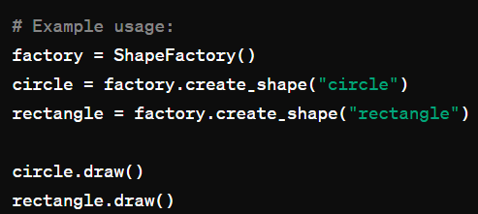
Factory pattern

Slide 9

Classification of Structural Design Patterns:
Adapter Method
Bridge Method
Composite Method
Decorator Method
Facade Method
Proxy Method
FlyWeight Method

Slide 10

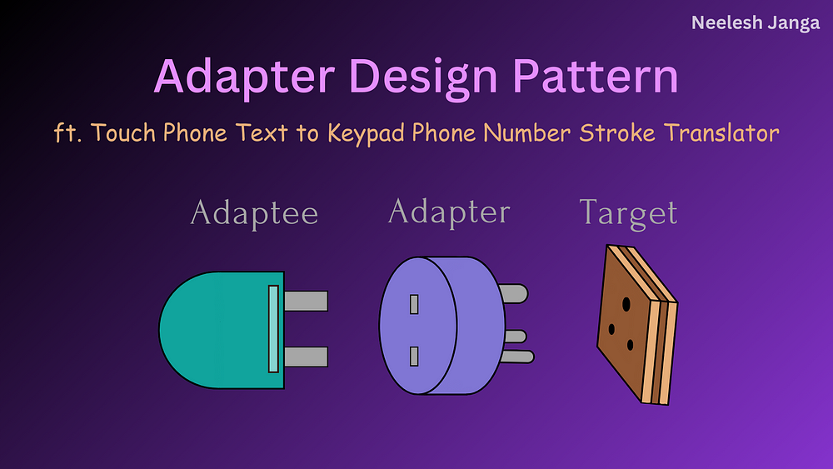
Adapter Pattern
Adapter is a structural design pattern that allows objects with incompatible interfaces to collaborate.
allows a class to work with interfaces it wouldn’t normally be compatible with, making it a powerful tool for integrating disparate systems.

Slide 11
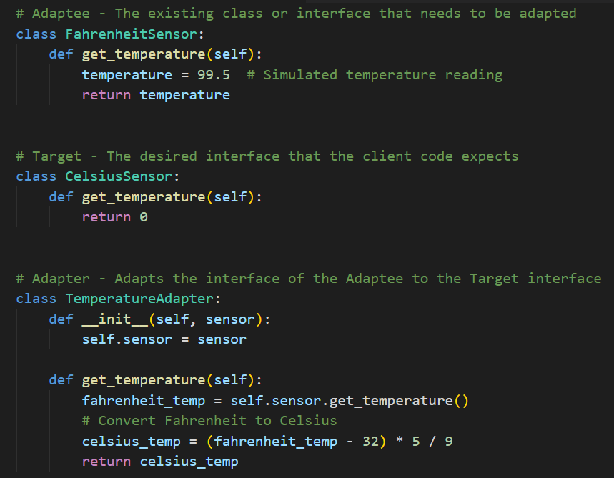
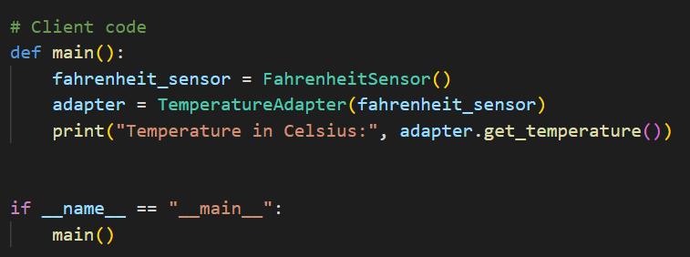
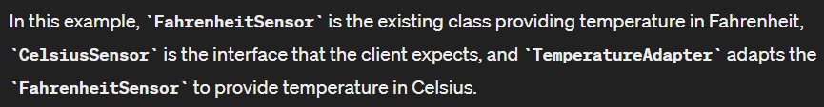
Adapter Pattern

Slide 12
Decorator Pattern
Decorator is a structural design pattern that lets you attach new behaviors to objects by placing these objects inside special wrapper objects that contain the behaviors.
"The ability to attach additional responsibilities to an object dynamically. Decorators, provide a flexible alternative to subclassing for extending functionality."

Slide 13
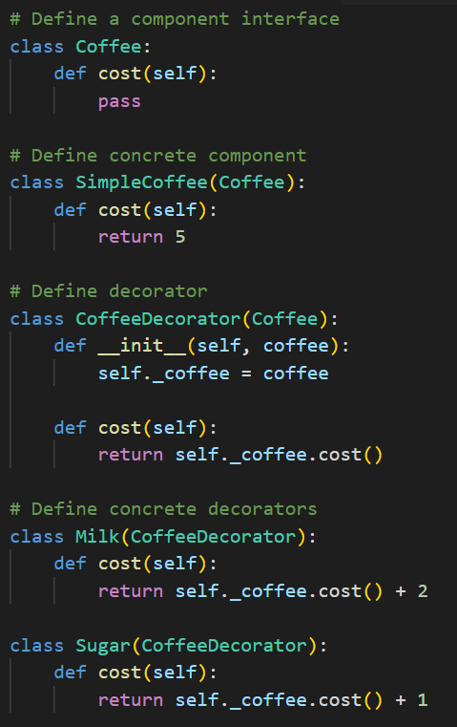
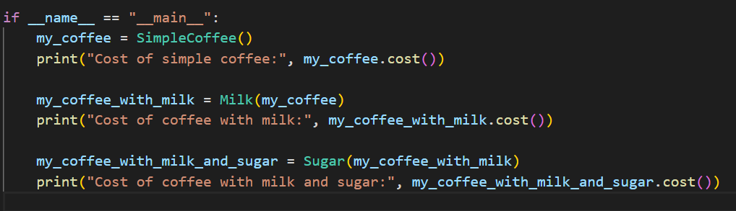
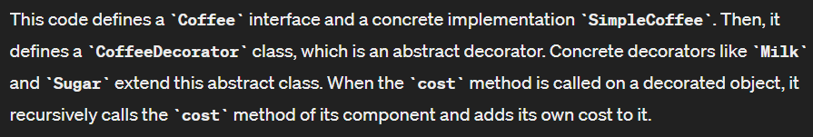
Decorator Pattern

Slide 14
3. Behavioral pattern
Behavioral patterns are all about identifying the common communication patterns between objects and realize these patterns. These patterns are concerned with algorithms and the assignment of responsibilities between objects.

Slide 15
Classification of Behavioral Design Patterns :–
Chain of Responsibility Method
Command Method
Iterator Method
Mediator Method
Memento Method
Observer Method
State Method
Strategy Method
Template Method
Visitor Method

Slide 16
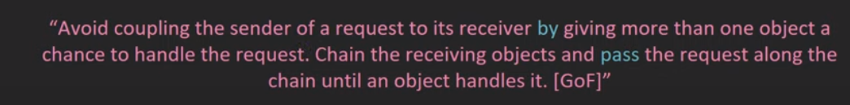
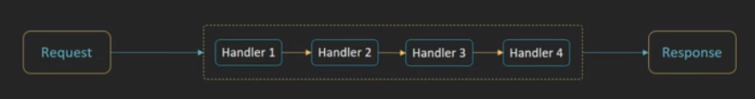
Chain of Responsibility Method

Slide 17
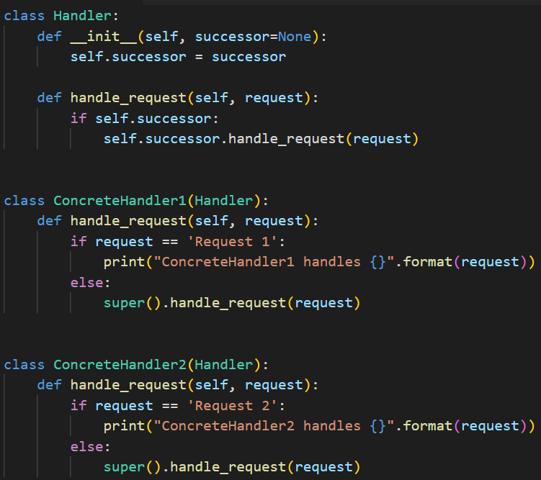
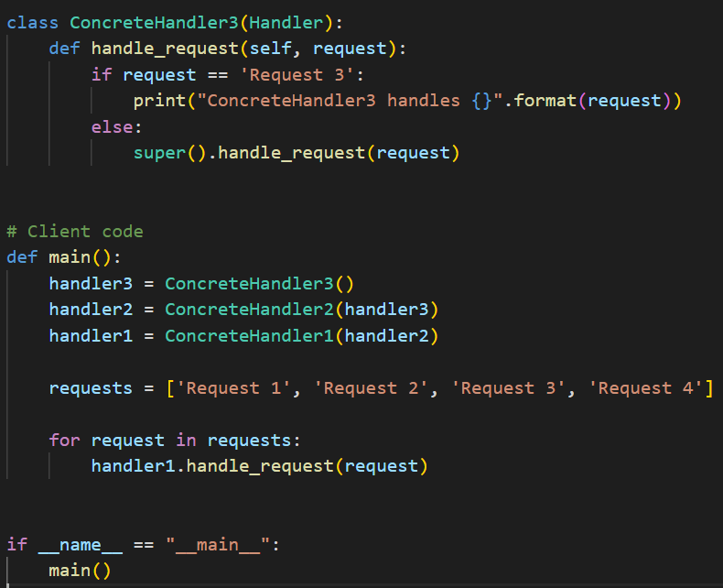
Chain of Responsibility Method

Slide 18
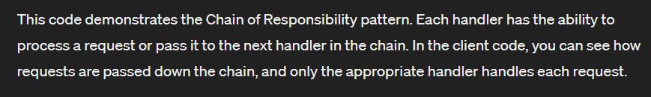

Slide 19

Thank you

